Slide 1




Methodological support on advanced methods for accessing, ingesting and linking textual information using semantic analysis and natural language processing
Some methodological details
September 2022

Slide 2
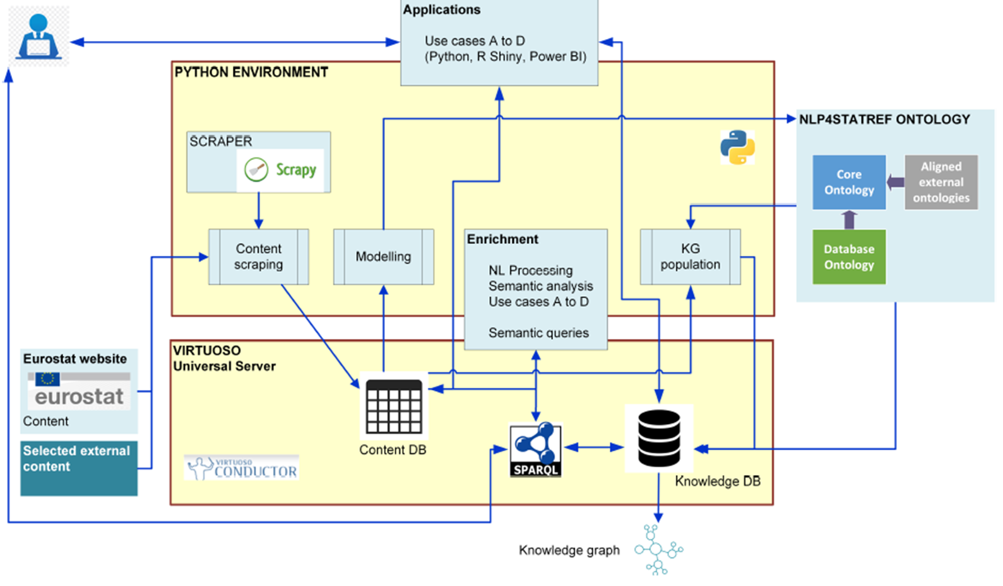
Methodology

Slide 3
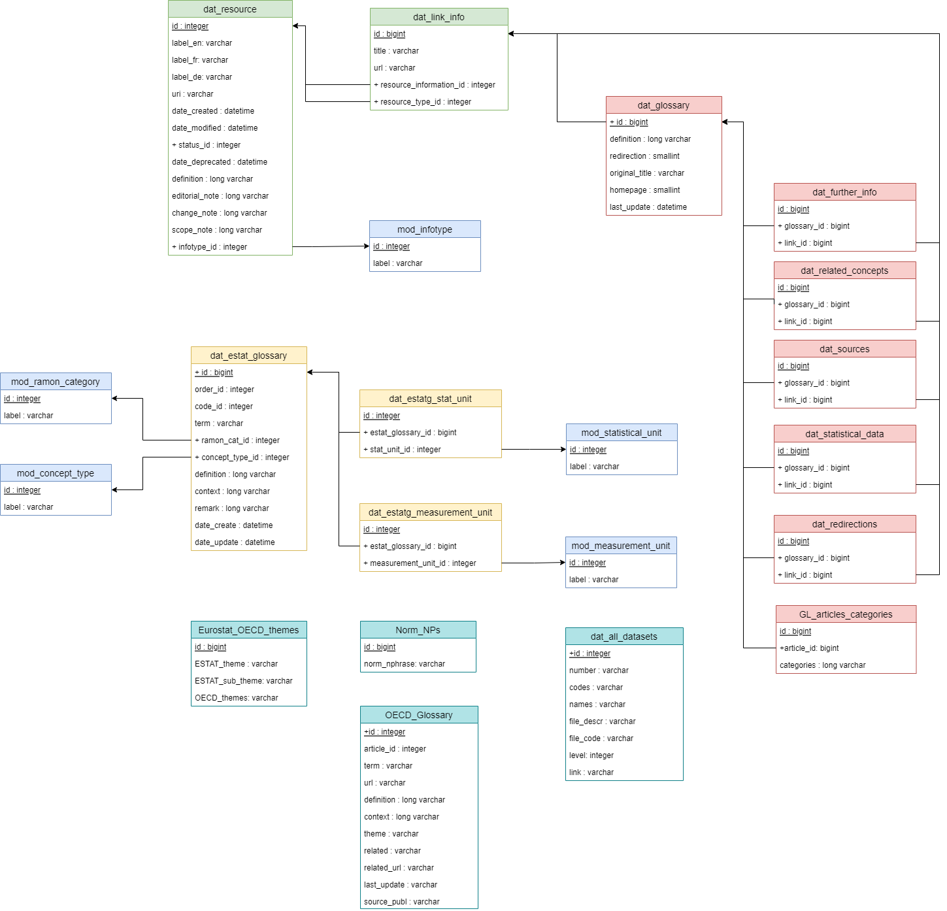
The Information Repository (1)
Part of the schema of the Content Database
SE Glossary articles
Eurostat Concepts &
Definitions Database
OECD Glossary
Hierarchy of Eurostat database

Slide 4
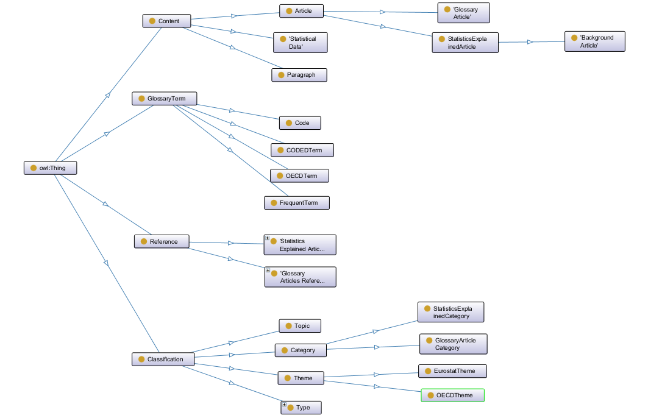
The Information Repository (2)
Knowledge Database: the top-level hierarchy of classes in the main ontology
Complemented by Linked Open Data (LOD) standard vocabularies – ‘alignment’
Alignment = logical consistency
(*) A separate ontology for the statistical datasets
(*)
See the latest documentation which describes all ontologies, the alignment and the ontology files structure

Slide 5
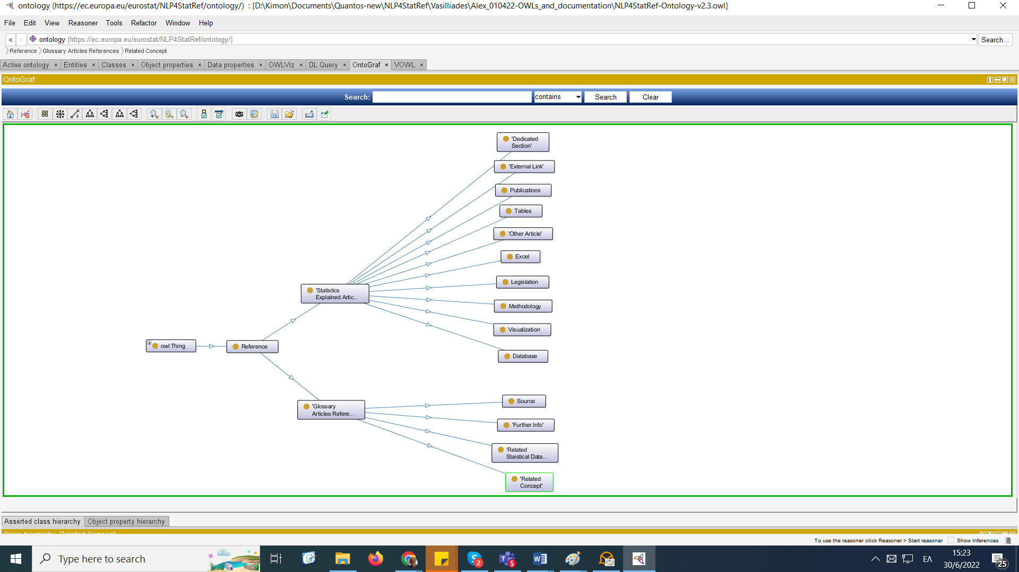
The Information Repository (3)
Knowledge Database: the sub-classes of the Reference class
References in SE articles
References in SE Glossary articles

Slide 6
The Information Repository (4)
Knowledge Database: example of a SPARQL query: load the SE Glossary articles (much faster than the corresponding SQL query)
DEFINE input:inference <https://ec.europa.eu/eurostat/NLP4StatRef/knowledge/>
PREFIX estat: <https://ec.europa.eu/eurostat/NLP4StatRef/ontology/>
PREFIX estatdata: <https://ec.europa.eu/eurostat/NLP4StatRef/knowledge/>
select ?a ?title ?url ?content where {
?a estat:GlossaryArticle .
?a estat:title ?title .
?a estat:hasURL ?url.
?a estat:content ?content .
filter(!regex(?content, "^(The revision|Redirect to)"))
filter( regex(?url, "Glossary:"))
}
Data cleansing with regular expressions
Programmatic access with the SPARQLWrapper Python library

Slide 7
Enrichment (1)
The task of extending an existing ontology with additional concepts and semantic relations and placing them at the correct position in the ontology
The most successful attempts were:
The application of topic modelling, and
The identification of noun phrases
Topic modelling with the Latent Dirichlet Allocation (LDA) algorithm(*):
Documents are represented as random mixtures over latent topics, where each topic is characterized by a distribution over words
(*) Blei, D. M., Ng, A. Y., & Jordan, M. I. (2003). Latent Dirichlet Allocation. J. Mach Learn Res 3, 993–1022.

Slide 8
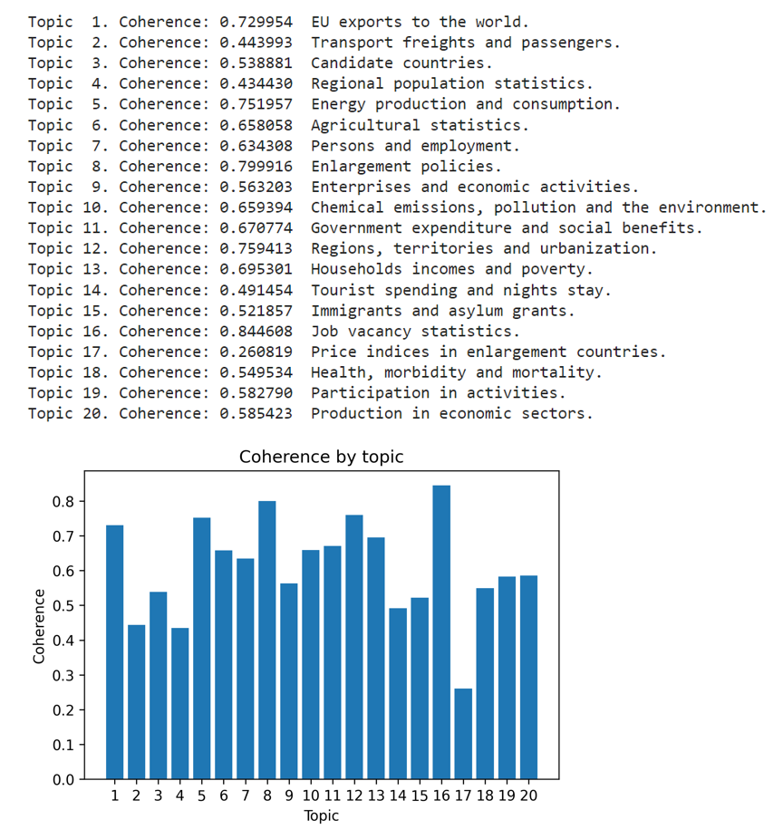
Enrichment (2)
Example with inputs from Statistics Explained articles (use case A – ‘Asset querying’ – MS Power BI application)
The number of topics is set by the user: small → broad thematic areas, large → narrow thematic areas
Here: 20 topics
Used Gensim’s module, which follows the Variational Expectation-Maximisation (VEM) approach
(The alternative is Gibbs sampling)
Topics are subject to human interpretation
20 topics and their interpretations

Slide 9
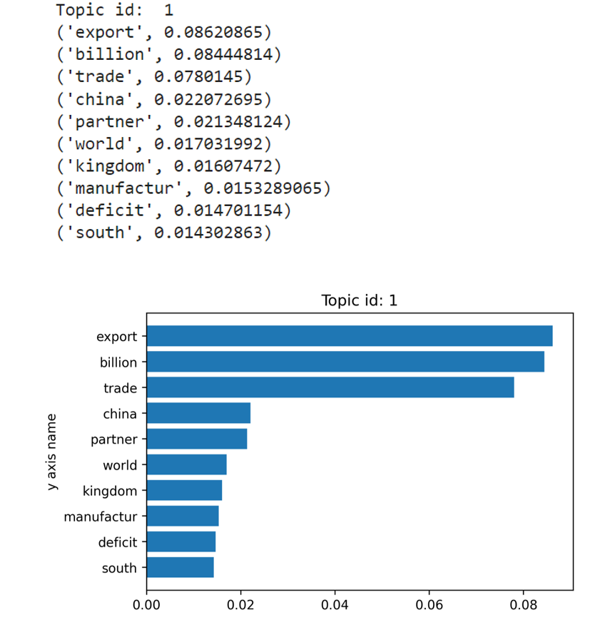
Enrichment (3)
Example with inputs from Statistics Explained articles: the first topic, interpreted as ‘EU exports to the world’ and its 10 most associated words (descending degree of ‘contribution’)
Interpretations based on:
The most associated words in a topic
The most representative text (SE article) in a topic

Slide 10
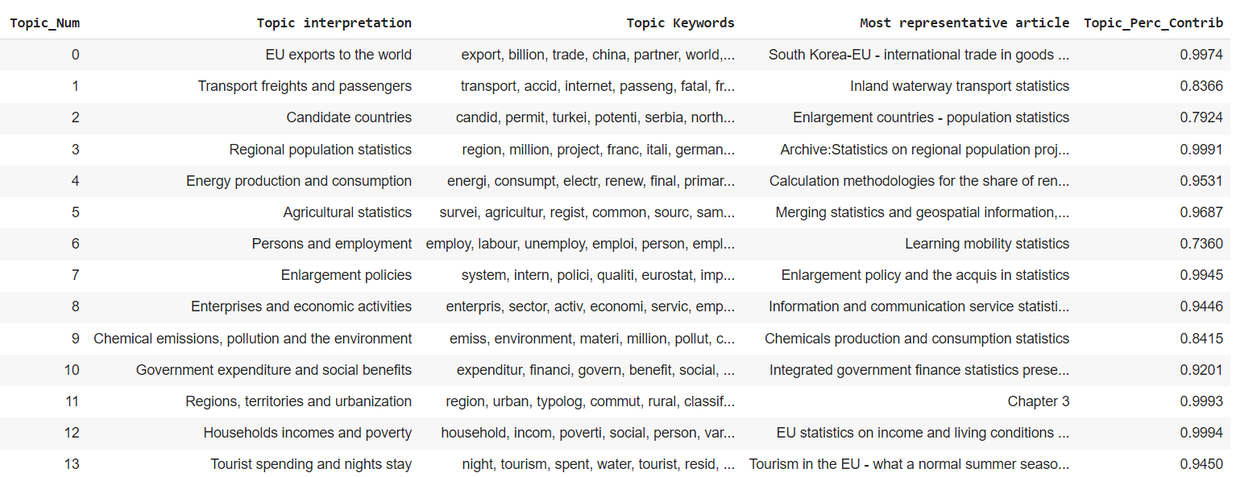
Enrichment (4)
Topic keywords and most representative articles per topic

Slide 11
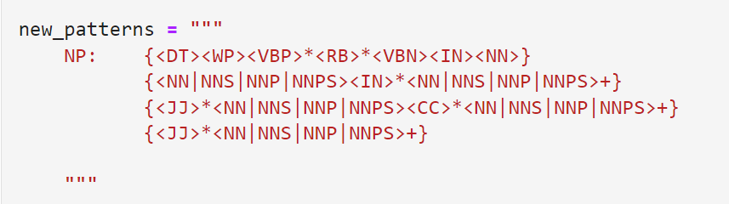
Enrichment (5)
Identification of noun phrases
Using NLTK, based on a pattern consisting of Point-of-Speech (PoS) tags
A purely grammatical approach
Pattern used from Petschauer, L. (2015). iPython-based tutorial for Noun Phrase chunking with the NLTK. Pycon 2015. https://github.com/lukewrites/NP_chunking_with_nltk/blob/master/NP_chunking_with_the_NLTK.ipynb
See Penn Treebank Project for the meaning of the tags

Slide 12
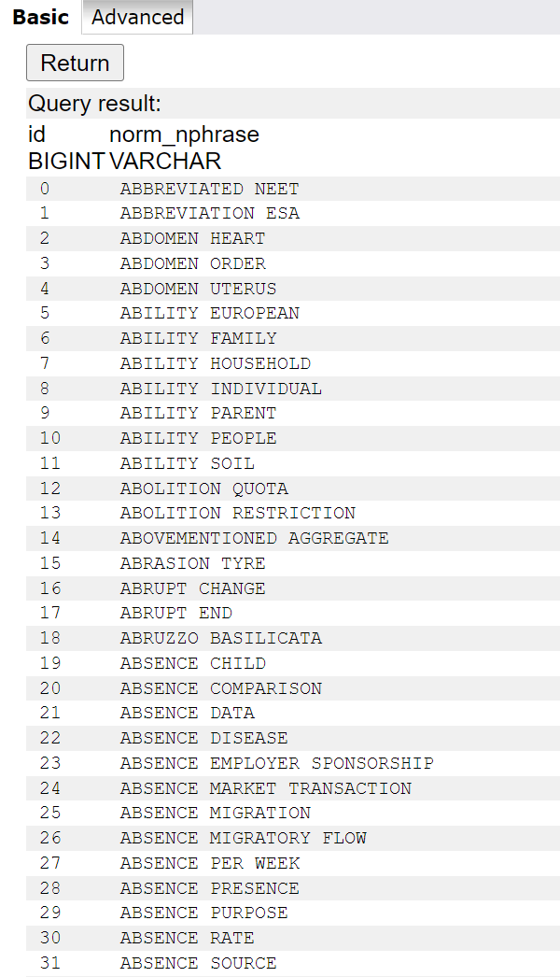
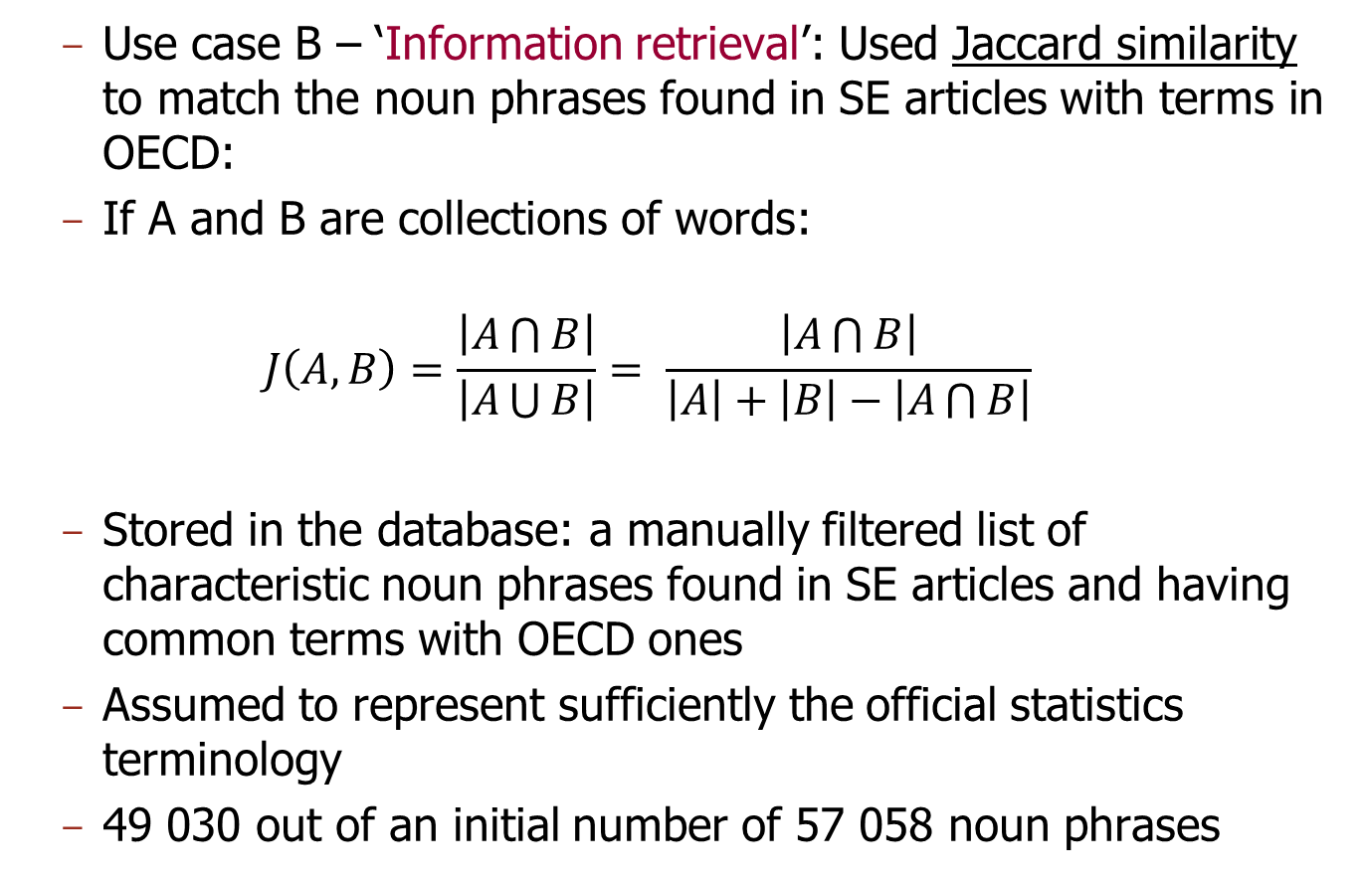
Enrichment (6)
Use case B – ‘Information retrieval’: Used Jaccard similarity to match the noun phrases found in SE articles with terms in OECD:
If A and B are collections of words:
$$J\left(A,B\right)=\frac{\left|A\bigcap{B}\right|}{\left|A\bigcup{B}\right|}= \frac{\left|A\bigcap{B}\right|}{\left|A\right|+\left|B\right|−\left|A\bigcap{B}\right|}$$
Stored in the database: a manually filtered list of characteristic noun phrases found in SE articles and having common terms with OECD ones
Assumed to represent sufficiently the official statistics terminology
49 030 out of an initial number of 57 058 noun phrases

Slide 13
Additional methodological information for use case A (1)
Query builder
Based on n-grams and special dictionaries
We used texts from the SE articles and the SE Glossary articles, extracted n-grams with n = 2–4 from these texts, and put the stems of the first (n-1) terms as keys in three corresponding dictionaries
The values in these dictionaries were the original terms – continuations found in the n-grams, together with their counts and the relevant URLs
A backtrack mechanism was used to fall back to a lower-order dictionary when no match was found

Slide 14
Additional methodological information for use case A (2)
Faceted search
Used an alignment of the themes / sub-themes hierarchy with the categories tagging:
For each article, initialise the related themes in an empty list and similarly, the related sub-themes in another empty list
Scan the categories associated with the article
If a category has the same name with a theme, add the theme to the first list
Otherwise, if it has the same name with a sub-theme, add the corresponding theme to the first list and the sub-theme to the second list

Slide 15
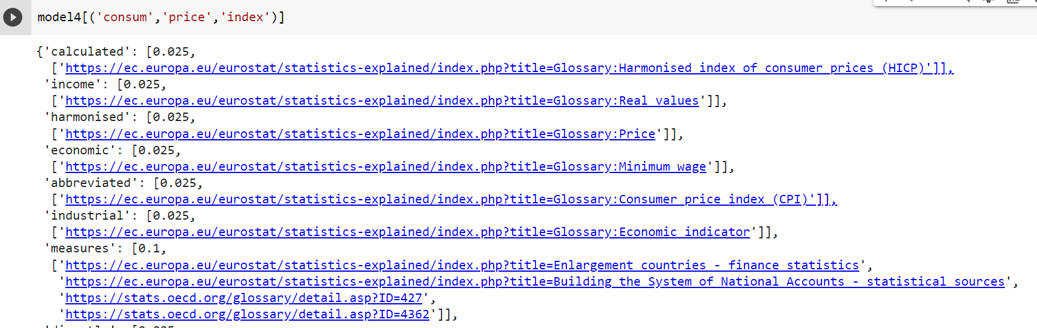
Additional methodological information for use case B (1)
Query builder
Used the same approach as in use case A, based on n-grams and special dictionaries, but with inputs from SE articles, SE Glossary articles and OECD Glossary terms
Example of an entry in the 4-grams dictionary. Some of the (many) values corresponding to the key – tuple of stems: (‘consum’, ‘price’, ‘index): ‘calculated’, ‘income’, ‘harmonised’, etc. :

Slide 16
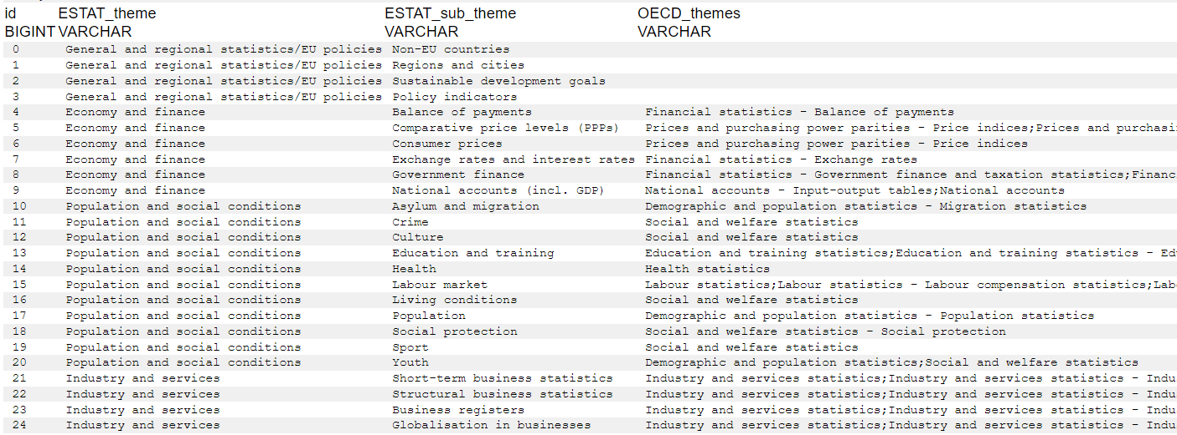
Additional methodological information for use case B (2)
Faceted search
Used a manually constructed (and rather subjective) correspondence file mapping Eurostat themes / sub-themes to (possibly multiple) OECD themes
Some few Eurostat themes – sub-themes do not have corresponding OECD themes

Slide 17
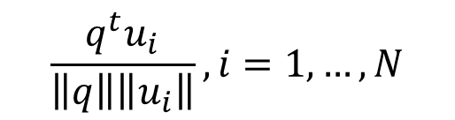
Additional methodological information for use case C (1)
Word embeddings
Used the very efficient Gensim’s Word2Vec model module
Matching of the user’s query with the descriptions of the datasets, using cosine similarity of average word vectors
Cosine similarities:
Where q is the average vector from the query and vectors u_{i}, i =1,..,N are the average vectors from the descriptions of the N datasets
The latter are pre-computed to save time in the UI
$$\frac{q^{t}u_{i}}{\left\|q\right\|\left\|u_{i}\right\|}, i=1,…,N$$

Slide 18
Additional methodological information for use case C (2)
The CBoW model(*): attempts to predict a word based on the context, i.e. previous and subsequent words
The Skip-gram (SG) model has a reverse architecture
It attempts to predict the probability distribution of nearby words to one input word
(*) Continuous-Bag-of-Words: see Mikolov, T., Sutskever, I., Chen, K., Corrado, G. S., and Dean, J. (2013). Distributed Representations of Words and Phrases and their Compositionality. In Advances in neural information processing systems, pp. 3111-3119

Slide 19
Additional methodological information for use case C (3)
Topic Modelling and Word embeddings
Use the word vectors produced by the previous method
Apply topic modelling to a large enough corpus (SE articles and SE Glossary articles) and a large number of topics (1 000)
Keep the top 10 keywords per topic and extend them with their closest words based on the word vectors → ‘enhanced topic modelling vocabulary’
Enrich the initial query with close words from the word vectors and with related words from ConceptNet (using two methods to demonstrate access to this ontology – see ConceptNet’s Web API)
Find both types of matches:
i) Using the lemmas (or stems) from the enriched query, which belong to the enhanced topic modelling vocabulary
ii) Using all lemmas (or stems) from the enriched query
Sort the results first by the number of matches in (i), then by the number of matches in (ii), so that the most significant matches have priority

Slide 20
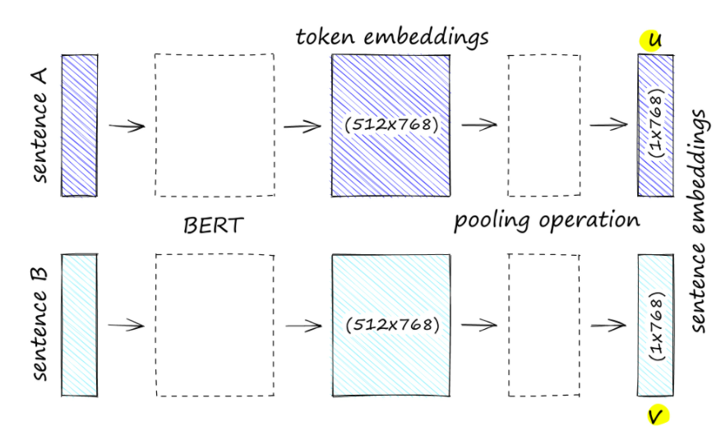
Additional methodological information for use case C (4)
The BERT model(*)
The theory of BERT models is out of scope here
We used SBERT (Sentence-Bert): ‘Sentence Embeddings Using Siamese BERT-Networks’, Reimers, N., & Gurevych, I. (2019): An improvement of the original BERT algorithm which reduces dramatically the computational complexity. See https://www.sbert.net/
(*) BERT: Bidirectional Encoder Representations from Transformers

Slide 21
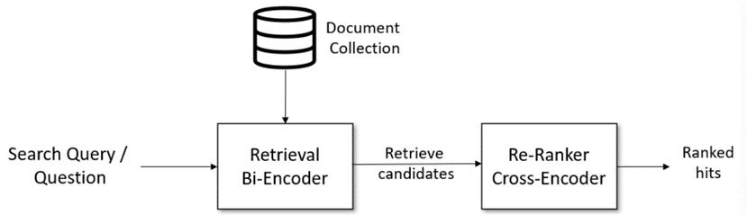
Additional methodological information for use case C (5)
Customized pipeline with bi-encoders and cross-encoders
Bi-Encoders produce for a given sentence a sentence embedding; Sentences are passed to BERT independently and can be compared with cosine similarity
In Cross-Encoders, sentences are passed to BERT simultaneously and a similarity score is produced by a classifier (no sentence embeddings)
(query, hit) combination
Best practice: Use a Bi-Encoder to retrieve the top most similar sentences to a query. Then, use a Cross-Encoder to re-rank these hits by computing a score for every (query, hit)

Slide 22
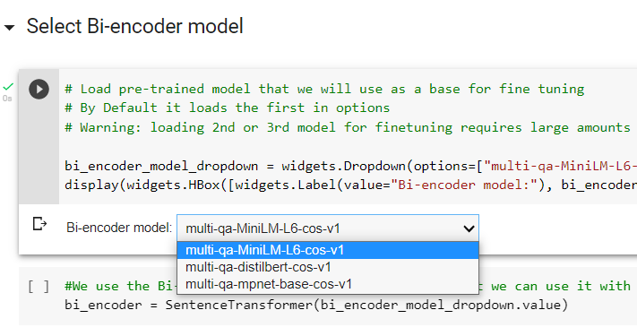
Additional methodological information for use case C (6)
Select pre-trained bi-encoder model
Collect pairs of the form (title [is related to], content) from SE Glossary articles, SE articles, OECD Glossary terms and the entries of CODED
Avoid too long texts because anything above 512 characters is truncated! (for example, split SE articles into sections, separate context and definitions in SE Glossary entries, etc.)
Fine-tuning: split data to train-test-validation and carry out training

Slide 23
Additional methodological information for use case C (7)
Then:
Read the table with Eurostat’s database tree
Encode each entry into the vector space using a) the dataset descriptions only, b) the full-path descriptions of the datasets (excluding the name of the first branch, i.e. ‘Database by themes’, ‘Tables by themes’, etc.)
The above in order to have this option at run-time
Pre-compute these encodings to handle the queries faster
Given a query, encode similarly the query and find the closest n entries
Then re-rank the top hits using the cross-encoder

Slide 24
Additional methodological information for use case D (1)
Could not use actual Questions & Answers (Q&As) database collected (not suitable)
We decided to use a complete conversational AI framework, although using only a subset of its features
It is expected that the operation of the solution will, as a by-product, enable to collect suitable Q&As, and these will be incorporated in the operation of the databot in the future
Ideally, have the users note if they found what they wanted, and if so, which specific result(s) answered their query
The selected framework, after evaluation of several conversational AI frameworks: DeepPavlov

Slide 25
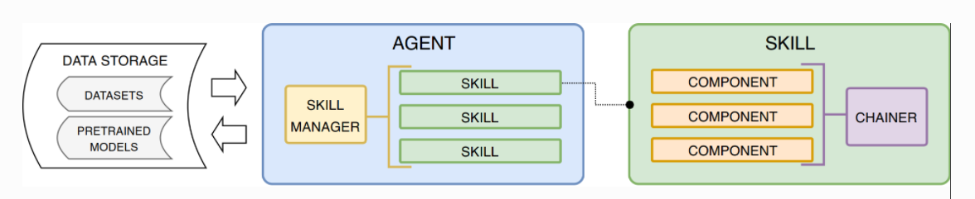
Additional methodological information for use case D (2)
The architecture of the DeepPavlov framework
This modular organization of Components with pipelines–Chainers is reflected in the definition of these elements in JSON configuration files, in an Object-Oriented-Programming (OOP) way
Each Component has an associated class, and its inputs and outputs correspond to the arguments in the _init_() and _call_() methods of the class
A flexible architecture which allows customization

Slide 26
Additional methodological information for use case D (3)
DeepPavlov’s framework contains a number of pre-trained models, to support common NLP tasks(*)
It also includes two pre-defined Skills, which are essentially complete bots:
Goal-oriented bot: a customizable bot, which allows predicting responses in a goal-oriented dialog (typically used in commercial settings which aim at finding a “solution”)
ODQA bot – Open domain question answering: a skill that accepts free-form questions about practically anything and outputs an answer based on its Wikipedia knowledge (too generic for our purposes)
(*) Burtsev, M. S., Seliverstov, A. V., Airapetyan, R., Arkhipov, M., Baymurzina, D., Bushkov, N., & Zaynutdinov, M. (2018). DeepPavlov: Open-Source Library for Dialogue Systems. Proceedings of the ACL, (pp. 122-127)

Slide 27
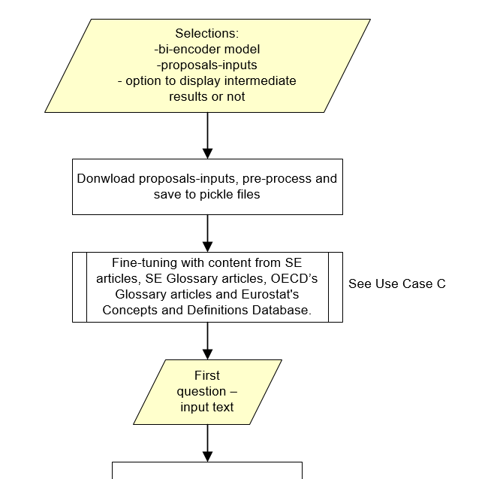

Additional methodological information for use case D (4)
We preferred to build our own models, because we wanted to use the BERT model from use case C and our own flow logic
Before the while-loop with the iterations of the conversation

Slide 28
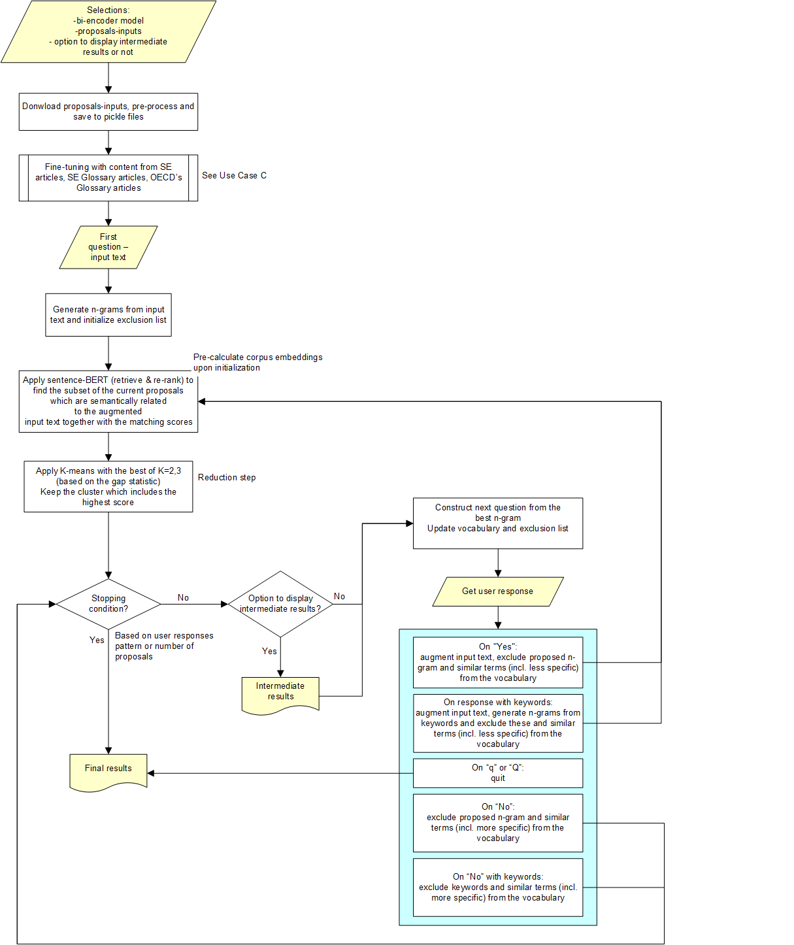
Additional methodological information for use case D (5)
The while-loop
Also here, inside the while-loop: as in use case C

Slide 29
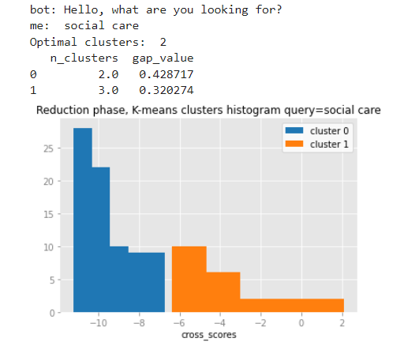
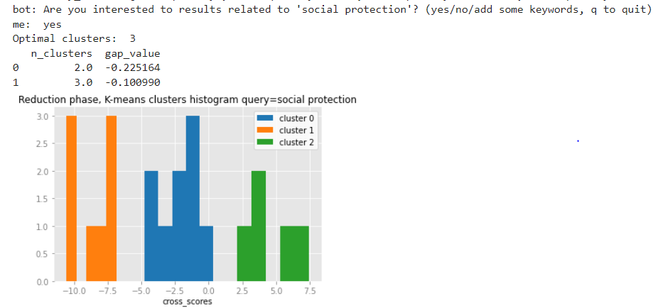
Additional methodological information for use case D (6)
The reduction step:
K-means clustering on the cross-scores with the best of K=2,3 according to the gap statistic
Example of change of optimal K in consecutive iterations:

Slide 30
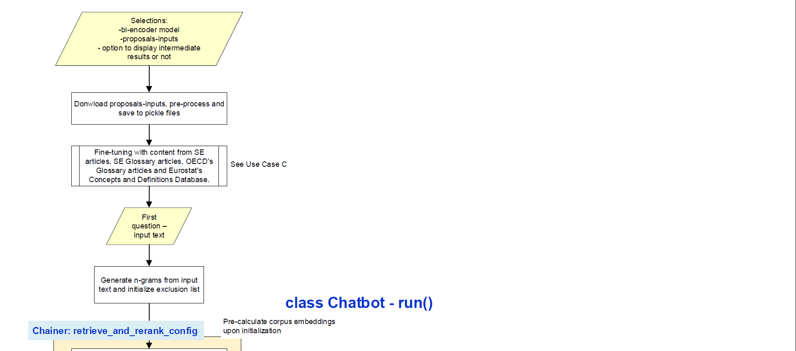
Additional methodological information for use case D (7)
Using DeepPavlov’s components (Chainers)

Slide 31
